Slide 1
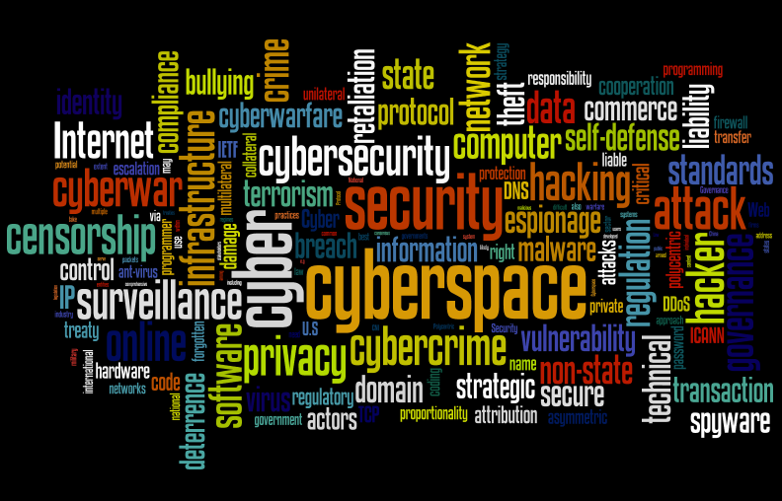
Information Security
Mr. Muhammad Hassan
Hassan.aridian2014@gmail.com
1

Slide 2
Marks Distribution
Assignments | 6
Project | -
Quiz | 6
Mid | 18
Final | 30
2

Slide 3
Possible training sessions
Penetration testing
Blockchain development
Hand-on IoT devices
3

Slide 4
Introduction to Security
Describe the challenges of securing information
Define information security and explain why it is important
Identify the types of attackers that are common today
List the basic steps of an attack
Describe the five basic principles of defense
CompTIA Security+ Guide to Network Security Fundamentals, Fifth Edition
4
Notes:
4
Objectives
Describe the challenges of securing information
Define information security and explain why it is important
Identify the types of attackers that are common today
List the basic steps of an attack
Describe the five basic principles of defense

Slide 5
Books
CompTIA Security+ Guide to Network Security Fundamentals, Fifth Edition by Mark Ciampa
Corporate Computer Security, by Randall J. Boyle, 3th Edition.
5

Slide 6
Certification
Certified Information Systems Security Professional (CISSP) is an independent information security certification granted by the International Information System Security Certification Consortium, also known as (ISC)².
The CompTIA Security+ certification is an internationally recognized validation of foundation-level security skills and knowledge.
6

Slide 7
Challenges of Securing Information
Security figures prominently in 21st century world
Personal security
Information security (focused on protecting the electronic information of organizations and users)
Securing information
No simple solution
Many different types of attacks
Defending against attacks often difficult
Information security continues to rank as the number one concern of IT managers
and tens of billions of dollars are spent annually on computer security, the number of successful attacks continues to increase.
Security+ Guide to Network Security Fundamentals, Fourth Edition
7
Notes:
7

Slide 8
Today’s Security Attacks
Examples of recent attacks
Fake anti-virus
Taking control of wireless cameras
ATM machine attacks (Malware called Ploutus)
Taking over Twitter accounts
Attackers using online sites such as Craigslist and eBay to lure victims to download malware
CompTIA Security+ Guide to Network Security Fundamentals, Fifth Edition
8
Notes:
8
Today’s Security Attacks
Examples of recent attacks
Attack on a credit card processing company that handles prepaid debit cards
Taking control of wireless cameras
ATM machine attacks
Taking over Twitter accounts
Serial server attacks
Attackers using online sites such as Craigslist and eBay to lure victims to download malware
Penetration of Apple’s very own network

Slide 9
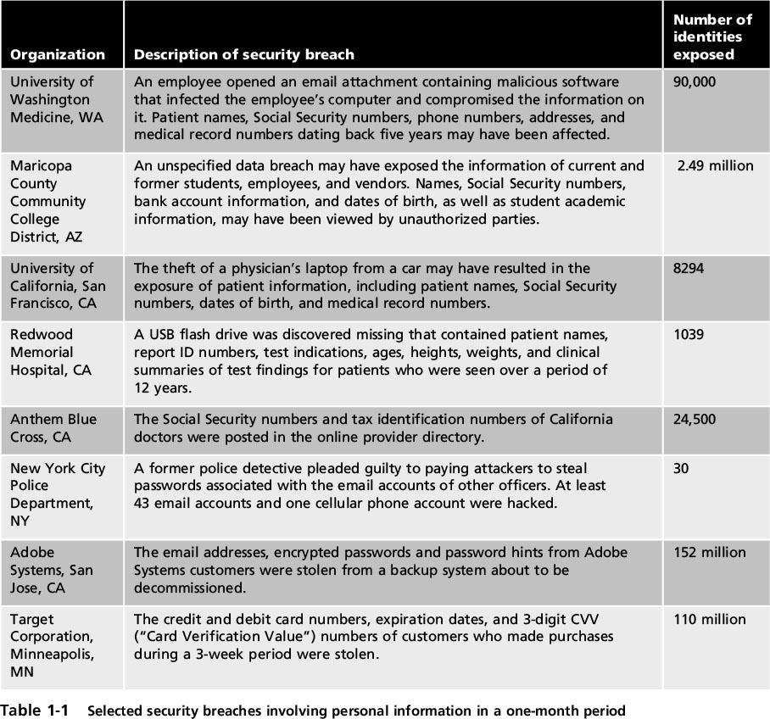
Today’s Security Attacks
CompTIA Security+ Guide to Network Security Fundamentals, Fifth Edition
9
Notes:
9
Today’s Security Attacks
Table 1-1 Selected security breaches involving personal information in a one-month period

Slide 10
The Sony Data Breaches
Sony Corporation
Japanese multinational corporation founded in 1946 that focuses on electronics, games, entertainment, and financial services
Employs about 146,300 people and has annual revenues of about $72.3 billion
Sony is widely known for its televisions, digital imaging, audio/video hardware, PCs, semiconductors, electronic components, and gaming platform.
1-10

Slide 11
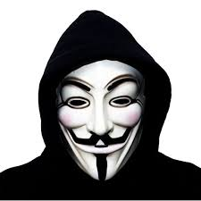
1.1: The Sony Data Breaches
The First Attack
April 17-19, 2011
Attacks happened a few weeks after the large earthquake, tsunami, and reactor meltdowns
Used SQL injection to steal 77 million accounts
Turned off access to PlayStation Network (PSN)
Publicly acknowledges intrusion a week after the intrusion, on April 26th
CEO, Kazuo Hirai, issues public apology
Hacking group “Anonymous” is suspected
1-11

Slide 12
The Sony Data Breaches
The Second Attack
May 1st, 2011 – Sony Online Entertainment
Similar SQL injection attack used to steal additional 24.6 million accounts
Turned off access to all Sony Online Entertainment servers
CEO, Kazuo Hirai, issues written response to US Congress (May 4th) about steps to prevent future attacks
Some PSN services start to come online on May 15th
1-12

Slide 13
The Sony Data Breaches
The Third Attack
June 2nd, 2011 – SonyPictures.com
Similar SQL injection attack used to steal additional 1 million accounts
SonyPictures.com is immediately shut down
Hacking group LulzSec claims responsibility and issues press statement
1-13

Slide 14
The Sony Data Breaches
LulzSec press statement
“Greetings folks. We're LulzSec, and welcome to Sownage. Enclosed you will find various collections of data stolen from internal Sony networks and websites, all of which we accessed easily and without the need for outside support or money.
We recently broke into SonyPictures.com and compromised over 1,000,000 users' personal information, including passwords, email addresses, home addresses, dates of birth, and all Sony opt-in data associated with their accounts. Among other things, we also compromised all admin details of Sony Pictures (including passwords) along with 75,000 ‘music codes’ and 3.5 million ‘music coupons’.”
1-14

Slide 15
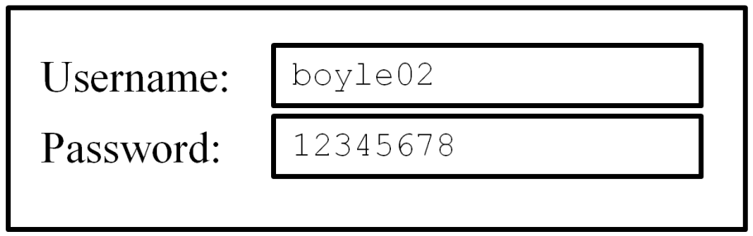
The Sony Data Breaches
SQL statement below shows parameters passed to a database for a legitimate login
SELECT FROM Users WHERE username=‘boyle02’ AND password=‘12345678’;
1-15

Slide 16
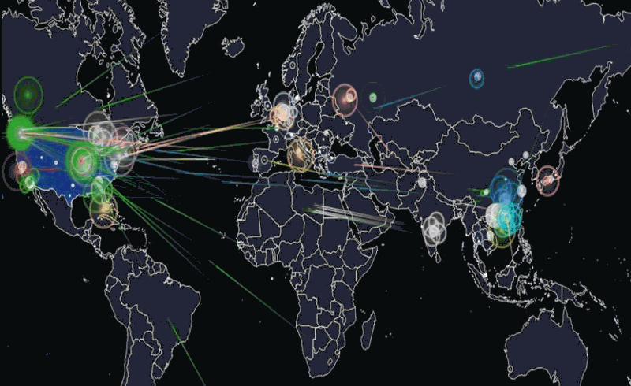
Difficulties in Defending Against Attacks
Universally connected devices
Increased speed of attacks
Greater sophistication of attacks
Availability and simplicity of attack tools
Faster detection of vulnerabilities
16
Notes:
16
Difficulties in Defending Against Attacks
Universally connected devices
Increased speed of attacks
Greater sophistication of attacks
Availability and simplicity of attack tools
Faster detection of vulnerabilities

Slide 17
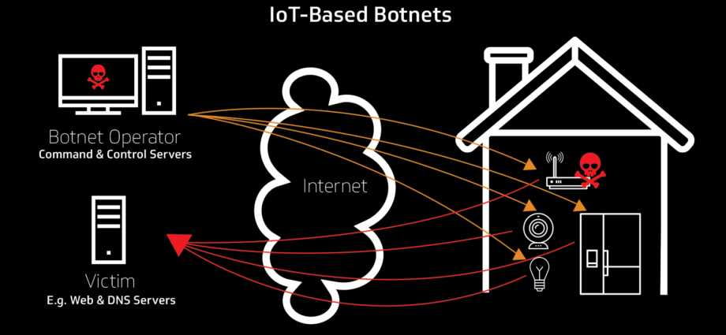
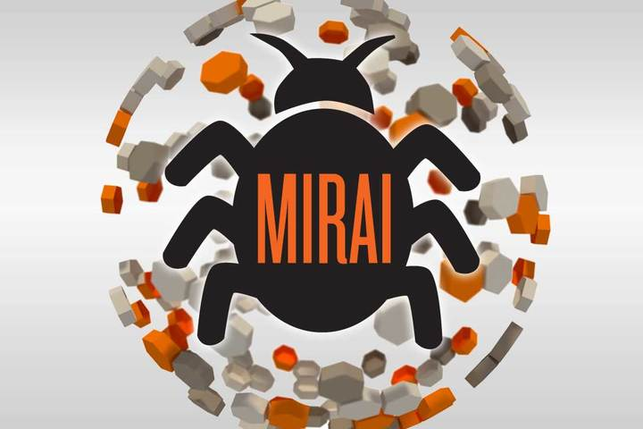
Next generation attacks
The DDoS attack on Dyn DNS was carried out using Mirai malware botnet — Mirai is a DDoS nightmare turning Internet of things (IoT) into a botnet of things.
17

Slide 18
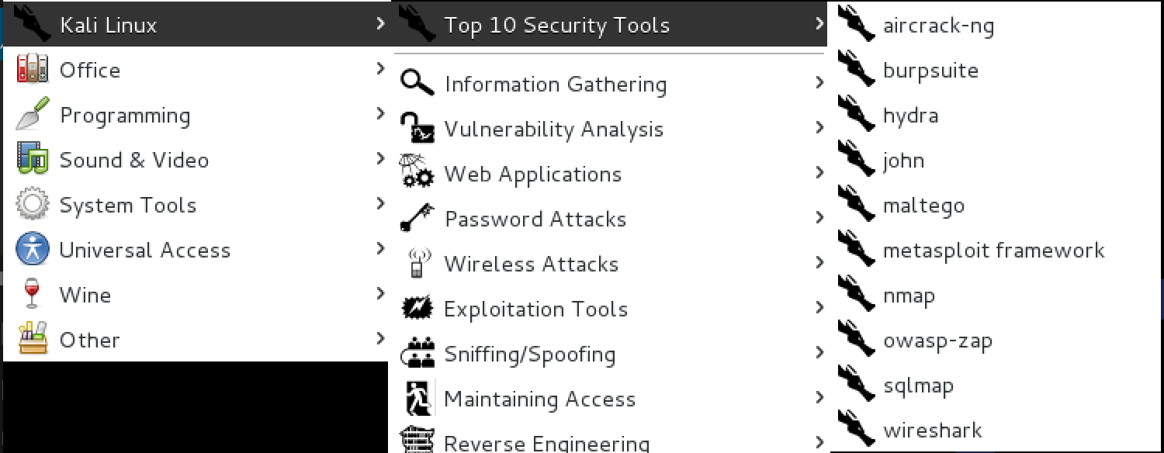
Kali Linux
CompTIA Security+ Guide to Network Security Fundamentals, Fifth Edition
18

Slide 19
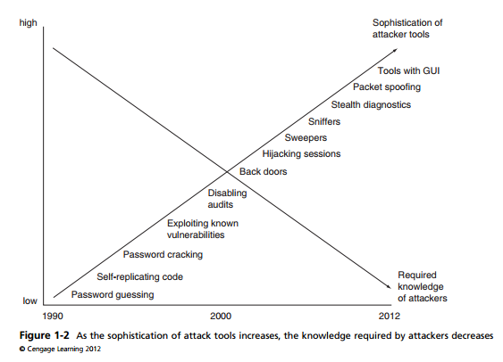
CompTIA Security+ Guide to Network Security Fundamentals, Fifth Edition
19

Slide 20
Difficulties in Defending Against Attacks
Delays in security updating
Weak security update distribution
Distributed attacks
User confusion
CompTIA Security+ Guide to Network Security Fundamentals, Fifth Edition
20
Notes:
20
Difficulties in Defending Against Attacks
Delays in security updating
Weak security update distribution
Distributed attacks
Introduction of BYOD
User confusion

Slide 21
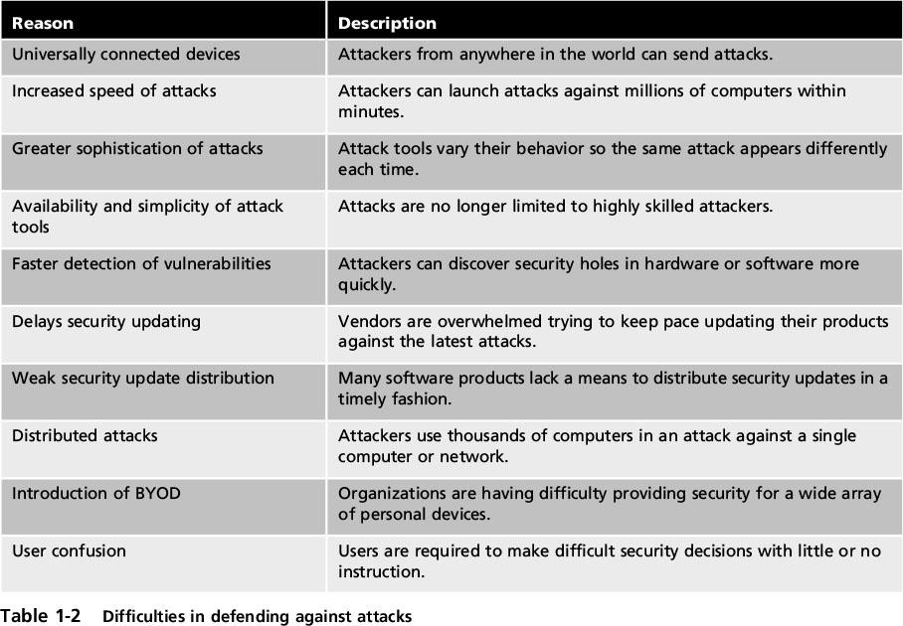
Difficulties in Defending Against Attacks
CompTIA Security+ Guide to Network Security Fundamentals, Fifth Edition
21
Notes:
21
Difficulties in Defending Against Attacks
Table 1-2 Difficulties in defending against attacks

Slide 22
What Is Information Security?
Before defense is possible, one must understand:
Exactly what security is
How security relates to information security
The terminology that relates to information security
CompTIA Security+ Guide to Network Security Fundamentals, Fifth Edition
22
Notes:
22
What Is Information Security?
Before defense is possible, one must understand:
Exactly what security is
How security relates to information security
The terminology that relates to information security

Slide 23
Understanding Security
Security is:
The goal to be free from danger
The process that achieves that freedom
Harm/danger may come from one of two sources:
From a direct action that is intended to inflict damage
From an indirect and unintentional action
As security is increased, convenience is often decreased
The more secure something is, the less convenient it may become to use
CompTIA Security+ Guide to Network Security Fundamentals, Fifth Edition
23
Notes:
Understanding Security
Security is:
The goal to be free from danger
The process that achieves that freedom
Harm/danger may come from one of two sources:
From a direct action that is intended to inflict damage
From an indirect and unintentional action
As security is increased, convenience is often decreased
The more secure something is, the less convenient it may become to use
23

Slide 24
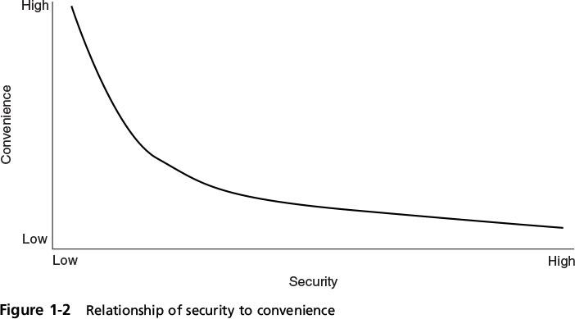
Understanding Security
CompTIA Security+ Guide to Network Security Fundamentals, Fifth Edition
24
Notes:
Understanding Security
Figure 1-2 Relationship of security to convenience
24

Slide 25
Defining Information Security
Information security - the tasks of securing information that is in a digital format:
Manipulated by a microprocessor
Stored on a storage device
Transmitted over a network
Information security goal - to ensure that protective measures are properly implemented to ward off attacks and prevent the total collapse of the system when a successful attack occurs
CompTIA Security+ Guide to Network Security Fundamentals, Fifth Edition
25
Notes:
25
Defining Information Security
Information security - the tasks of securing information that is in a digital format:
Manipulated by a microprocessor
Stored on a storage device
Transmitted over a network
Information security goal - to ensure that protective measures are properly implemented to ward off attacks and prevent the total collapse of the system when a successful attack occurs

Slide 26
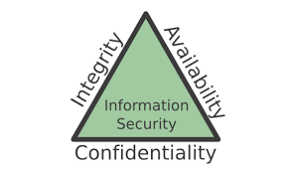
Defining Information Security (cont’d.)
Three types of information protection: often called CIA
26
Notes:
26

Slide 27
Defining Information Security (cont’d.)
Three types of information protection: often called CIA
Confidentiality
In general, for confidentiality to be maintained on a network, data must be protected from unauthorized access, use, or disclosure while in storage, in process, and in transit.
Numerous attacks focus on the violation of confidentiality. These include:
capturing network traffic
stealing password files
social engineering
port scanning,
eavesdropping, sniffing, and so on.
27
Notes:
27

Slide 28
Defining Information Security (cont’d.)
Confidentiality
Violations of confidentiality are not limited to directed intentional attacks.
Events that lead to confidentiality breaches include
by not encrypting it before sending it to another person,
by falling prey to a social engineering attack,
by sharing a company’s trade secrets, or by not using extra care to protect confidential information when processing it.
documents left on printers, or even walking away from an access terminal while data is displayed on the monitor.
Numerous countermeasures
Encryption for data at rest (whole disk, database encryption)
Encryption for data in transit (IPSec, TLS, PPTP, SSH)
Access control (physical and technical)
28
Notes:
28

Slide 29
Quiz
Question: Confidentiality: Suppose you are making an online purchase and want to pay for it with your credit card. What is the best way to preserve confidentiality of your credit card information?
Check if the online connection is secured with SSL or TLS, you can then enter the credit card information.
CompTIA Security+ Guide to Network Security Fundamentals, Fifth Edition
29

Slide 30
Defining Information Security (cont’d.)
Three types of information protection: often called CIA
Integrity
Confidentiality and integrity depend on each other
Integrity is upheld when the assurance of the accuracy and reliability of information and systems is provided and any unauthorized modification is prevented.
Environments that enforce and provide this attribute of security ensure that attackers, or mistakes by users, do not compromise the integrity of systems or data.
Numerous attacks focus on the violation of integrity. These include viruses, logic bombs, unauthorized access, errors in coding and applications, malicious modification, intentional replacement, and system back doors.
30
Notes:
30

Slide 31
Defining Information Security (cont’d.)
Three types of information protection: often called CIA
Integrity
Events that lead to integrity breaches include (non-intentional)
accidentally deleting files
entering invalid data
altering configurations
Countermeasures
Hashing (data integrity)
Configuration management (system integrity)
Access control (physical and technical)
Software digital signing
Transmission cyclic redundancy check (CRC) functions
31
Notes:
31

Slide 32
Defining Information Security (cont’d.)
Three types of information protection: often called CIA
Availability
The third principle of the CIA Triad is availability, which means authorized subjects are granted timely and uninterrupted access to objects.
If a security mechanism offers availability, it offers a high level of assurance that the data, objects, and resources are accessible to authorized subjects.
There are numerous threats to availability.
These include device failure, software errors, and environmental issues (heat, static, flooding, power loss, and so on).
There are also some forms of attacks that focus on the violation of availability, including DoS attacks, and communication interruptions.
32
Notes:
32

Slide 33
Defining Information Security (cont’d.)
Three types of information protection: often called CIA
Availability
Countermeasures
Redundant array of independent disks (RAID)
Load balancing
Redundant data and power lines
Software and data backups
Co-location and offsite facilities
Rollback functions
Failover configurations
33
Notes:
33

Slide 34
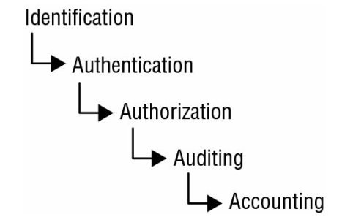
Defining Information Security (cont’d.)
Protections implemented to secure information
34
Notes:
34

Slide 35
Identification
A subject must provide an identity to a system to start the process of authentication, authorization, and accountability (AAA).
Providing an identity can involve typing in a username; swiping a smart card;
Authentication
The process of verifying or testing that the claimed identity is valid is authentication
Authentication requires from the subject additional information that must exactly correspond to the identity indicated.
This includes the password variations of PINs and passphrases
35
Notes:
35

Slide 36
Authorization
Grant ability to access information (After a person has provided authentication she may have the authority to access the credit card number or enter a room that contains the web server, provided the person has been given prior authorization)
Auditing
Recording a log of the events and activities related to the system and subjects.
Auditing, or monitoring, is the programmatic means by which a subject’s actions are tracked and recorded for the purpose of holding the subject accountable for their actions while authenticated on a system.
36
Notes:
36

Slide 37
Accounting (aka accountability) reviewing log files to check for compliance and violations in order to hold subjects accountable for their actions.
Nonrepudiation ensures that the subject of an activity or event cannot deny that the event occurred.
Nonrepudiation is an essential part of accountability
Nonrepudiation prevents a subject from claiming not to have sent a message, not to have performed an action, or not to have been the cause of an event.
It is made possible through identification, authentication, authorization, accountability, and auditing.
37
Notes:
37

Slide 38
Defining Information Security
Information security is achieved through a process that is a combination of three entities:
Information and the hardware
Software
Communications
These entities are protected in three layers:
Products
People
Policies and procedures
CompTIA Security+ Guide to Network Security Fundamentals, Fifth Edition
38
Notes:
38
Defining Information Security
Information security is achieved through a process that is a combination of three entities:
Information and the hardware
Software
Communications
These entities are protected in three layers:
Products
People
Policies and procedures

Slide 39
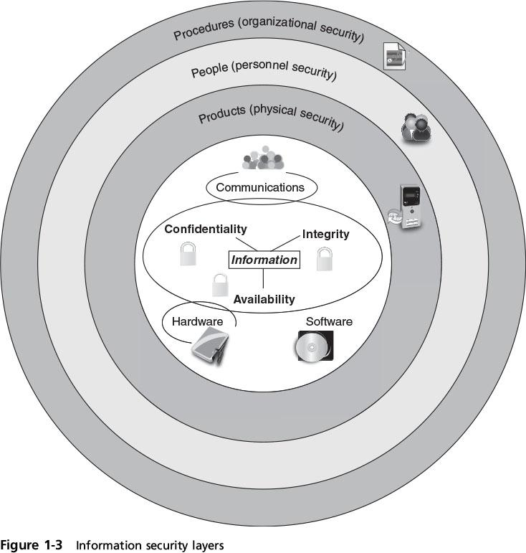
Defining Information Security
39
Notes:
39
Defining Information Security
Figure 1-3 Information security layers

Slide 40
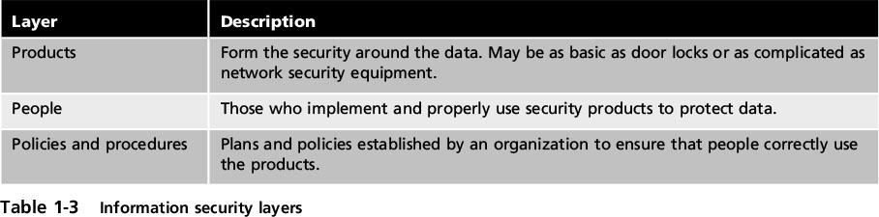
Defining Information Security
CompTIA Security+ Guide to Network Security Fundamentals, Fifth Edition
40
Notes:
40
Defining Information Security
Table 1-3 Information security layers

Slide 41
Information Security Terminology
Asset
Item of value
In an organization, assets have the following qualities: they provide value to the organization; they cannot easily be replaced without a significant investment in expense, time, worker skill, and/or resources;
Threat
Actions or events that have potential to cause harm
Threat agent
Person or element with power to carry out a threat
A threat agent could be a person attempting to break into a secure computer network.
It could also be a force of nature such as a hurricane that could damage computer equipment and thus destroy information, or it could be malicious software that attacks the computer network.
Security+ Guide to Network Security Fundamentals, Fourth Edition
41
Notes:
41

Slide 42
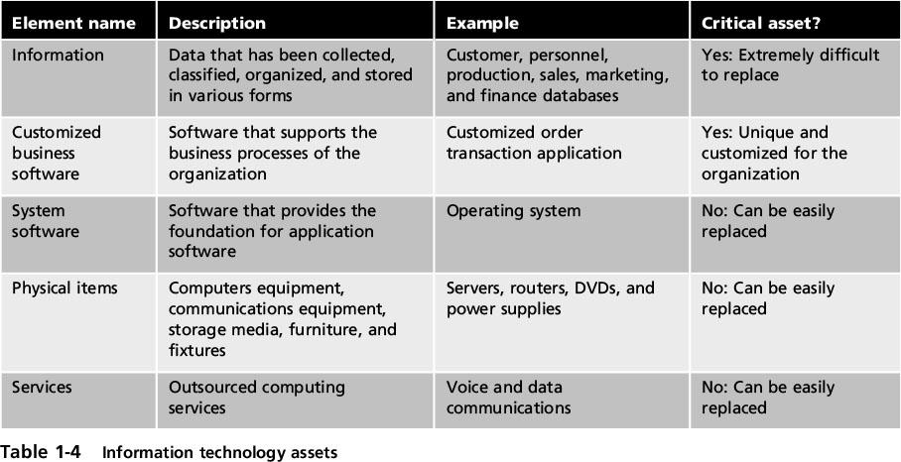
Information Security Terminology
CompTIA Security+ Guide to Network Security Fundamentals, Fifth Edition
42
Notes:
42
Information Security Terminology
Table 1-4 Information technology assets

Slide 43
Information Security Terminology
Vulnerability
Flaw or weakness that allows a threat agent to bypass security
Threat likelihood
Likelihood that threat agent will exploit vulnerability
Risk
A situation that involves exposure to some type of danger
CompTIA Security+ Guide to Network Security Fundamentals, Fifth Edition
43
Notes:
43
Information Security Terminology
Vulnerability
Flaw or weakness that allows a threat agent to bypass security
Threat vector
The means by which an attack can occur
Threat likelihood
Likelihood that threat agent will exploit vulnerability
Risk
A situation that involves exposure to some type of danger

Slide 44
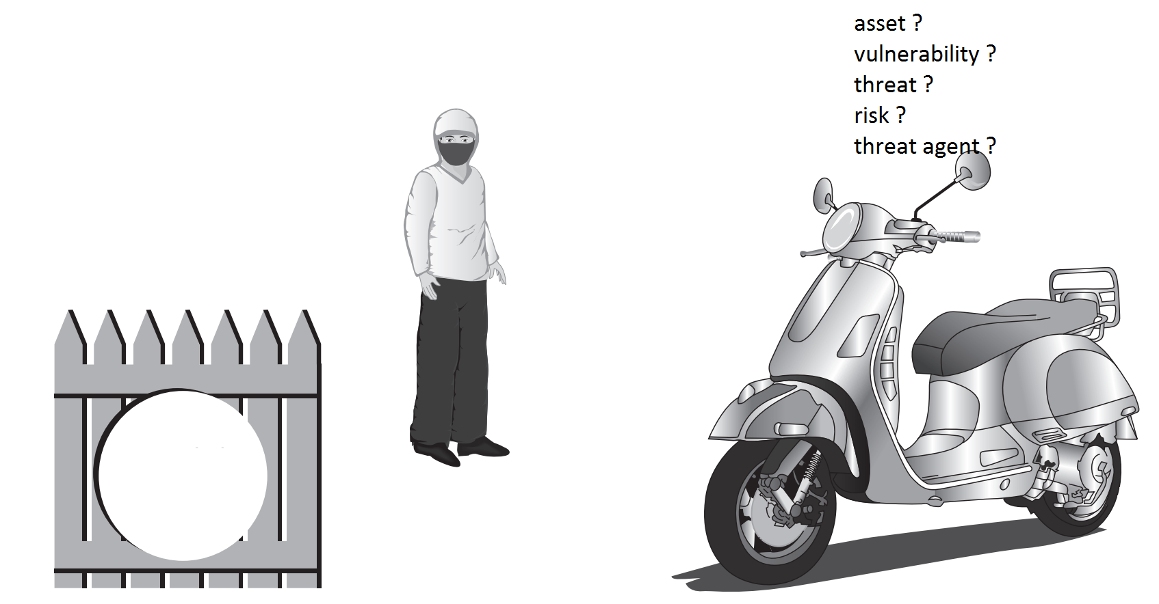
Security+ Guide to Network Security Fundamentals, Fourth Edition
44

Slide 45
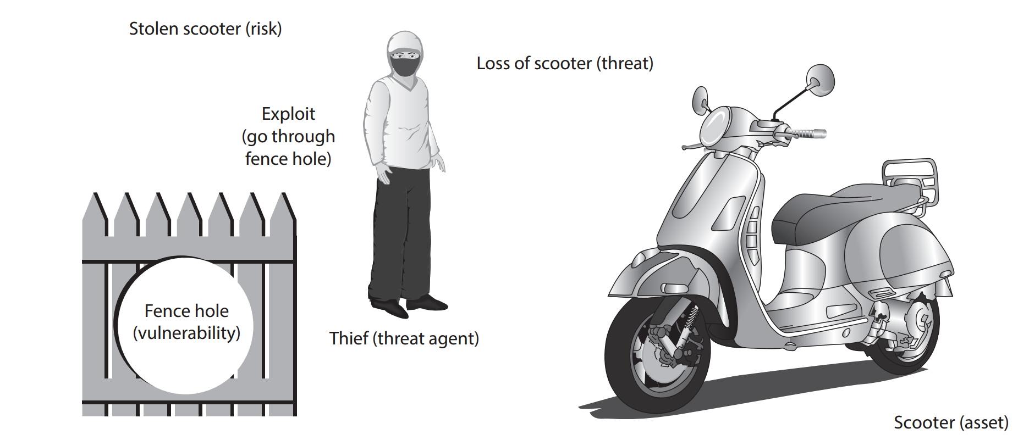
Figure 1-4 Information security components analogy
© Cengage Learning 2012
Security+ Guide to Network Security Fundamentals, Fourth Edition
45
Notes:
45

Slide 46
Information Security Terminology
Options to deal with risk:
Risk avoidance - involves identifying the risk but not engaging in the activity (i.e. not to buy the scooter)
Acceptance - risk is acknowledged but no steps are taken to address it (i.e. ignore the risk and buy the scooter any way)
Risk mitigation - the attempt to address the risks by making risk less serious (i.e. request the management to fix the fence by making the risk less serious)
Deterrence - understanding the attacker and then informing him of the consequences of his actions (i.e. put a sign board to warn the attacker of the consequences of stealing)
Transference - transferring the risk to a third party (i.e. insurance)
CompTIA Security+ Guide to Network Security Fundamentals, Fifth Edition
46
Notes:
46
Information Security Terminology
Options to deal with risk:
Risk avoidance - involves identifying the risk but not engaging in the activity
Acceptance - risk is acknowledged but no steps are taken to address it
Risk mitigation - the attempt to address the risks by making risk less serious
Deterrence - understanding the attacker and then informing him of the consequences of his actions
Transference - transferring the risk to a third party

Slide 47
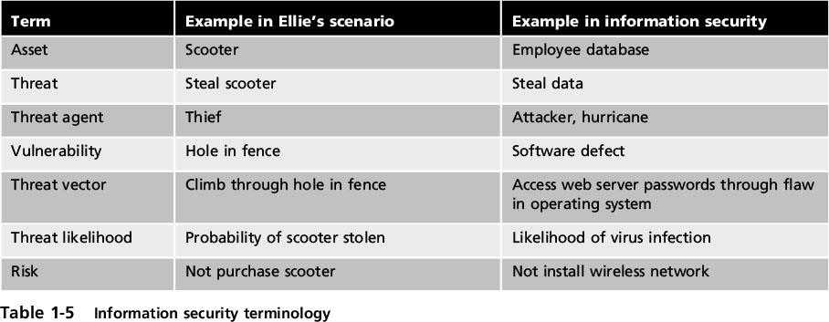
Information Security Terminology
CompTIA Security+ Guide to Network Security Fundamentals, Fifth Edition
47
Notes:
47
Information Security Terminology
Table 1-5 Information security terminology

Slide 48

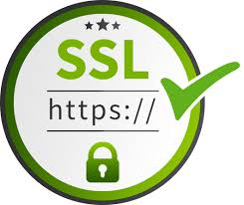
Case study: Heartbleed!
SSL is the main protocol for secure (encrypted) online communication!.
The SSL standard includes a heartbeat option, which allows a computer at one end of an SSL connection to send a short message to verify that the other computer is still online and get a response back.
Researchers found that it's possible to send a cleverly formed, malicious heartbeat message that tricks the computer at the other end into divulging secret information.
48

Slide 49
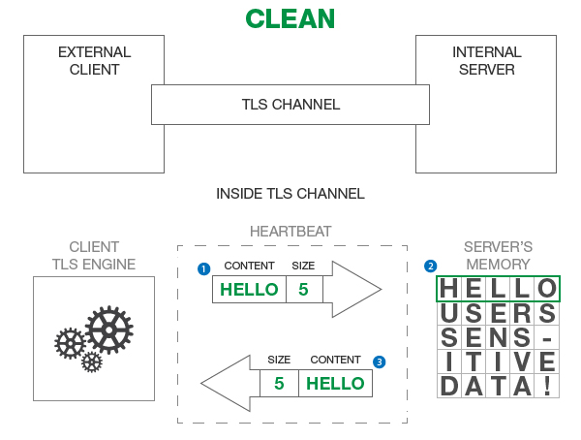
Case study: Heartbleed!
https://www.forumsys.com/api-security/how-to-fix-openssl-heartbleed-security-flaw/
49
Notes:
Please note that in the real world, the message content, as shown above, is not the actual representation of the Heartbeat exchange. We are picking arbitrary message content to simplify the example. The following steps describe the interaction between the client and server:
The client sends a message of size 5 bytes and the data content “HELLO”. If you count the number of characters in the word “HELLO”, the number corresponds to the 5 bytes included in the message (1 byte = 1 letter).
The server receives the message content “HELLO” and stores it in its memory so it can send it back as a “Heartbeat” response. There is also additional data stored in the server’s memory from other TLS channels that the server may have established with other clients. We represent that other data as “USERS SENS-ITIVE DATA!”.
The server then sends exactly the 5 byte message response which exactly corresponds to “HELLO” in server’s memory. The server does not leak any sensitive data from its memory.
49

Slide 50
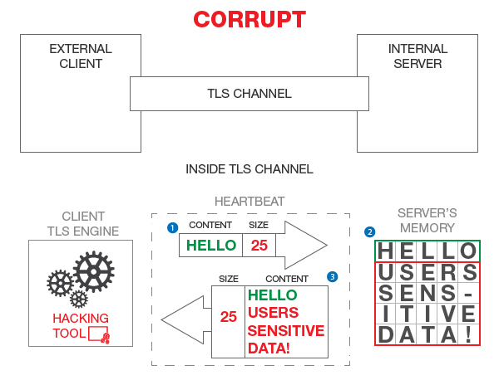
Case study: Heartbleed!
50
Notes:
The figure above illustrates a corrupt “Heartbeat” message flow where the attacker sends an incorrect size with the “HELLO” message content.
In this example, here are the three steps in the TLS channel work:
The client sends a message with size 25 of bytes but the content of the message really only contains 5 bytes (“HELLO”).
The server receives the message content “HELLO” and stores it in its memory so it can send it back as a “Heartbeat” response. Just like before, there is other data stored in the server memory from other different TLS channels.
The server then sends a 25 byte message response which exactly corresponds to number of characters in “HELLO” plus “USERS SENS-ITIVE DATA!” in server’s memory.
50

Slide 51
Case study: Heartbleed!
Malformed packet allows you to see server memory!
Passwords, keys, emails, visitor logs …..!
The attacker can ask for around 64,000 characters of plain text. And it doesn't just ask once, it can send malicious heartbeat messages over and over again, allowing the attacker to get back different fragments of the server's memory each time.
Fix: Don’t let the user tell you how much data to send back!!
This is a design ﬂaw
51

Slide 52

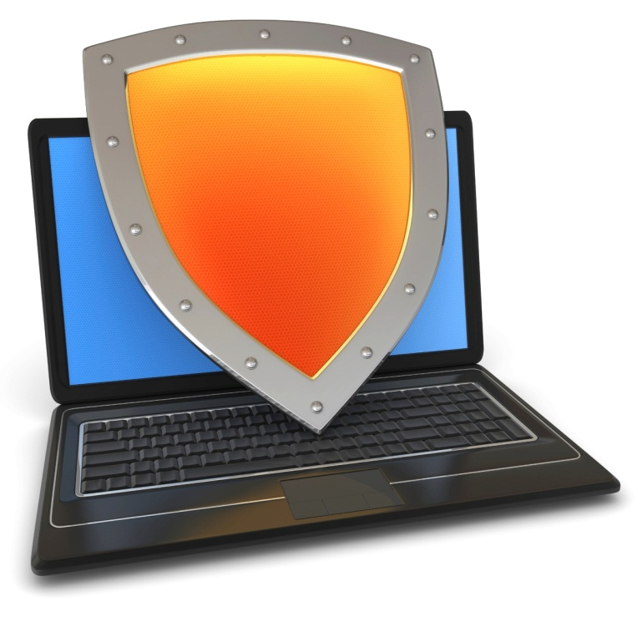
The Marketplace for Vulnerabilities
Notes:
In this segment I want to tell you about market places that have evolved around exploits and vulnerabilities
52

Slide 53
Marketplace for Vulnerabilities
Option 1: bug bounty programs (many)
Google Vulnerability Reward Program: up to $20K
Microsoft Bounty Program: up to $100K
Mozilla Bug Bounty program: $7500
Pwn2Own competition: $15K
Option 2:
Zero day initiative (ZDI), iDefense: $2K – $25K
Notes:
There are many people who work on finding vulnerabilities in software, such as Windows or software that runs on top of windows. Finding an explotable vulnerability can take months and the question is what to do when they find one. Most likely they publish an article in a security conference like Blackhat and boost their reputation. But it shouldn’t be too surprising that they can also make money from selling the vulnerability before announcing it at a conference. There are three options.
53

Slide 54
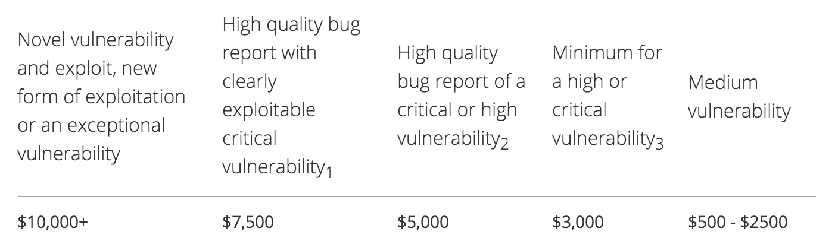
Example: Mozilla

Slide 55
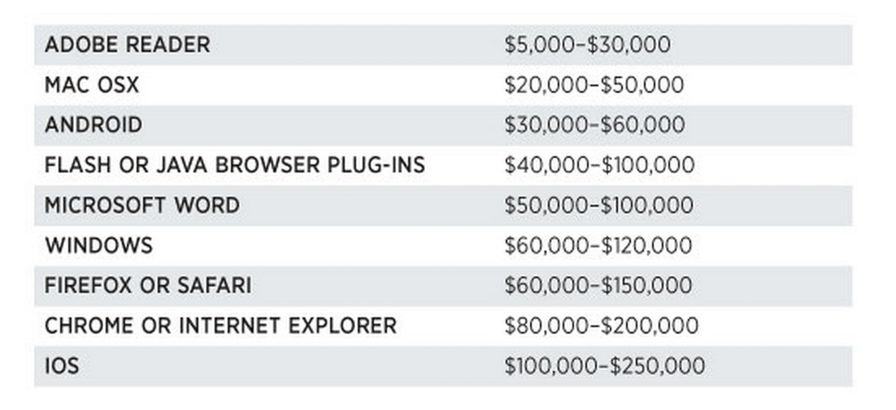
Marketplace for Vulnerabilities
Option 3: black market
Source: Andy Greenberg (Forbes, 3/23/2012 )
Notes:
Now, the 3rd option is to go to the black market. We don’t quite know the value of vulns. there, but I list here a few quotes that suggest that prices could be higher than with the other two options.
55

Slide 56
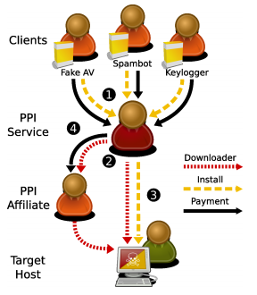
Marketplace for owned machines
Figure 1: The typical transactions in the PPI market. PPI clients provide software they want to have installed, and pay a PPI service to distribute the software (➊). The PPI service conducts downloader infections itself or employs affiliates that install the PPI’s downloader on victim machines(➋). The PPI service pushes out the client’s executables (➌). Affiliates receive commission for any successful installations they facilitated (➍).
Source: Cabalerro et al. (www.icir.org/vern/papers/ppi-usesec11.pdf)
Source: Cabalerro et al. (www.icir.org/vern/papers/ppi-usesec11.pdf)

Slide 57
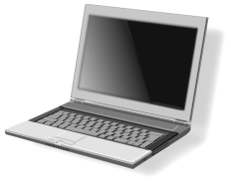
Marketplace for owned machines
clients
spam bot
keylogger
Cost: US - 100-180$ / 1000 machines
Asia - 7-8$ / 1000 machines
PPI service
Victims
Source: Cabalerro et al. (www.icir.org/vern/papers/ppi-usesec11.pdf)
Source: Cabalerro et al. (www.icir.org/vern/papers/ppi-usesec11.pdf)

Slide 58
Understanding the Importance of Information Security
Information security can be helpful in:
Preventing data theft
Thwarting identity theft
Avoiding the legal consequences of not securing information
Maintaining productivity
Foiling cyberterrorism
CompTIA Security+ Guide to Network Security Fundamentals, Fifth Edition
58
Notes:
58
Understanding the Importance of Information Security
Information security can be helpful in:
Preventing data theft
Thwarting identity theft
Avoiding the legal consequences of not securing information
Maintaining productivity
Foiling cyberterrorism

Slide 59
Preventing Data Theft
Preventing data from being stolen is often the primary objective of an organization’s information security
Business data theft involves stealing proprietary business information
Personal data theft involves stealing credit card numbers
CompTIA Security+ Guide to Network Security Fundamentals, Fifth Edition
59
Notes:
Preventing Data Theft
Preventing data from being stolen is often the primary objective of an organization’s information security
Business data theft involves stealing proprietary business information
Personal data theft involves stealing credit card numbers
59

Slide 60
Thwarting Identity Theft
Identity theft
Stealing another person’s personal information
Usually using it for financial gain
Example:
Steal person’s SSN
Create new credit card account to charge purchases and leave them unpaid
File fraudulent tax returns
CompTIA Security+ Guide to Network Security Fundamentals, Fifth Edition
60
Notes:
60
Thwarting Identity Theft
Identity theft
Stealing another person’s personal information
Usually using it for financial gain
Example:
Steal person’s SSN
Create new credit card account to charge purchases and leave them unpaid
File fraudulent tax returns

Slide 61
Avoiding Legal Consequences
Laws protecting electronic data privacy:
The Health Insurance Portability and Accountability Act of 1996 (HIPAA)
The Sarbanes-Oxley Act of 2002 (Sarbox)
The Gramm-Leach-Bliley Act (GLBA)
Payment Card Industry Data Security Standard (PCI DSS)
California’s Database Security Breach Notification Act (2003)
CompTIA Security+ Guide to Network Security Fundamentals, Fifth Edition
61
Notes:
61
Avoiding Legal Consequences
Laws protecting electronic data privacy:
The Health Insurance Portability and Accountability Act of 1996 (HIPAA)
The Sarbanes-Oxley Act of 2002 (Sarbox)
The Gramm-Leach-Bliley Act (GLBA)
Payment Card Industry Data Security Standard (PCI DSS)
California’s Database Security Breach Notification Act (2003)

Slide 62
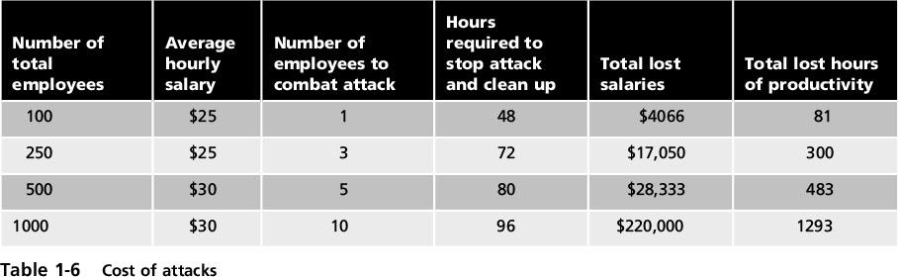
Maintaining Productivity
Post-attack clean up diverts resources away from normal activities
Time, money, and other resources
CompTIA Security+ Guide to Network Security Fundamentals, Fifth Edition
62
Notes:
62
Maintaining Productivity
Post-attack clean up diverts resources away from normal activities
Time, money, and other resources
Table 1-6 Cost of attacks

Slide 63
Foiling Cyberterrorism
Cyberterrorism
Any premeditated, politically motivated attack against information, computer systems, computer programs, and data
Designed to:
Cause panic
Provoke violence
Result in financial catastrophe
May be directed at targets such as the banking industry, power plants, air traffic control centers, and water systems
CompTIA Security+ Guide to Network Security Fundamentals, Fifth Edition
63
Notes:
63
Foiling Cyberterrorism
Cyberterrorism
Any premeditated, politically motivated attack against information, computer systems, computer programs, and data
Designed to:
Cause panic
Provoke violence
Result in financial catastrophe
May be directed at targets such as the banking industry, power plants, air traffic control centers, and water systems

Slide 64
Who Are the Attackers?
Hacker - person who uses computer skills to attack computers
Black hat hackers
Violate computer security for personal gain and the goal is to inflict malicious damage
White hat hackers
Goal to expose security flaws, not to steal or corrupt data
Gray hat hackers
Goal is to break into a system without owner’s permission, but not for their own advantage
CompTIA Security+ Guide to Network Security Fundamentals, Fifth Edition
64
Notes:
64
Who Are the Attackers?
Hacker - person who uses computer skills to attack computers
Black hat hackers
Violate computer security for personal gain and the goal is to inflict malicious damage
White hat hackers
Goal to expose security flaws, not to steal or corrupt data
Gray hat hackers
Goal is to break into a system without owner’s permission, but not for their own advantage

Slide 65
Who Are the Attackers?
Categories of attackers
Cybercriminals
Script kiddies
Brokers
Insiders
Cyberterrorists
Hactivists
State-sponsored attackers
CompTIA Security+ Guide to Network Security Fundamentals, Fifth Edition
65
Notes:
65
Who Are the Attackers?
Categories of attackers
Cybercriminals
Script kiddies
Brokers
Insiders
Cyberterrorists
Hactivists
State-sponsored attackers

Slide 66
Cybercriminals
A network of attackers, identity thieves, spammers, financial fraudsters
More highly motivated
Willing to take more risk
Well-funded
More tenacious
The goal of a cybercriminal is financial gain
Cybercrime - targeted attacks against financial networks and the theft of personal information
CompTIA Security+ Guide to Network Security Fundamentals, Fifth Edition
66
Notes:
66
Cybercriminals
A network of attackers, identity thieves, spammers, financial fraudsters
More highly motivated
Willing to take more risk
Well-funded
More tenacious
The goal of a cybercriminal is financial gain
Cybercrime - targeted attacks against financial networks and the theft of personal information

Slide 67
Cybercriminals
Financial cybercrime is divided into two categories:
Individuals and businesses
Use stolen data, credit card numbers, online financial account information, or Social Security numbers to profit from victims
Businesses and governments
Attempt to steal research on a new product so they can sell it to a foreign supplier
CompTIA Security+ Guide to Network Security Fundamentals, Fifth Edition
67
Notes:
67
Cybercriminals
Financial cybercrime is divided into two categories:
Individuals and businesses
Use stolen data, credit card numbers, online financial account information, or Social Security numbers to profit from victims
Businesses and governments
Attempt to steal research on a new product so they can sell it to an unscrupulous foreign supplier
Advanced Persistent Threat (APT) - multiyear intrusion campaign that targets highly sensitive economic, proprietary, or national security information

Slide 68
Script Kiddies
Script kiddies - individuals who want to attack computers yet they lack the knowledge of computers and network needed to do so
They download automated hacking software (scripts) from websites
Over 40 percent of attacks require low or no skills
Exploit kits - automated attack package that can be used without an advanced knowledge of computers
Script kiddies either rent or purchase them
CompTIA Security+ Guide to Network Security Fundamentals, Fifth Edition
68
Notes:
68
Script Kiddies
Script kiddies - individuals who want to attack computers yet they lack the knowledge of computers and network needed to do so
They download automated hacking software (scripts) from websites
Over 40 percent of attacks require low or no skills
Exploit kits - automated attack package that can be used without an advanced knowledge of computers
Script kiddies either rent or purchase them

Slide 69
tools
Nmap (Network Mapper) | Free
Used to Scan Ports and Map Networks
Metasploit Penetration Testing Software | Free & Paid
Vulnerability Exploitation Tool
John The Ripper | Free
Password Cracking Tool (offline dictionary attack)
THC Hydra | Free
Network login Password Cracking Tool (dictionary and brute force)
CompTIA Security+ Guide to Network Security Fundamentals, Fifth Edition
69

Slide 70
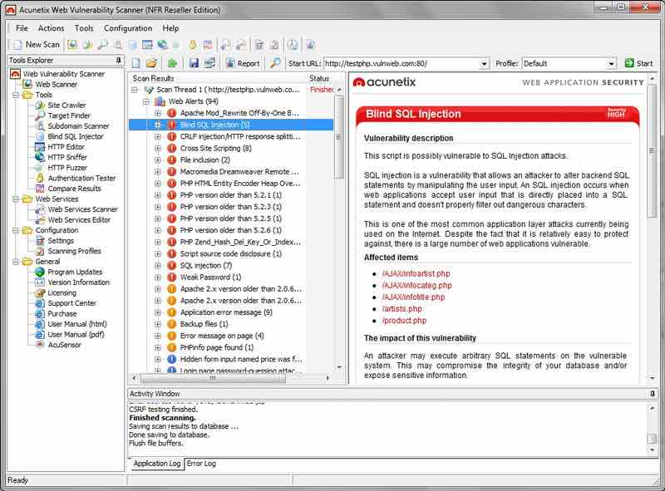
tools
Aircrack-ng | Free
Wifi Password Cracking Tool
Acunetix is a web vulnerability scanner (WVS) that scans and finds out the flaws in a website that could prove fatal. This multi-threaded tool crawls a website and finds out malicious Cross-site Scripting, SQL injection, and other vulnerabilities.
70

Slide 71
tools
Nessus Vulnerability Scanner
Vulnerabilities that allow a remote hacker to control or access sensitive data on a system.
Misconfiguration (e.g. open mail relay, missing patches, etc.).
Default passwords, a few common passwords, and blank/absent passwords on some system accounts. Nessus can also call Hydra (an external tool) to launch a dictionary attack.
Denials of service against the TCP/IP stack by using malformed packets
CompTIA Security+ Guide to Network Security Fundamentals, Fifth Edition
71

Slide 72
tools
Nessus Vulnerability Scanner
Vulnerabilities that allow a remote hacker to control or access sensitive data on a system.
Misconfiguration (e.g. open mail relay, missing patches, etc.).
Default passwords, a few common passwords, and blank/absent passwords on some system accounts. Nessus can also call Hydra (an external tool) to launch a dictionary attack.
Denials of service against the TCP/IP stack by using malformed packets
CompTIA Security+ Guide to Network Security Fundamentals, Fifth Edition
72

Slide 73
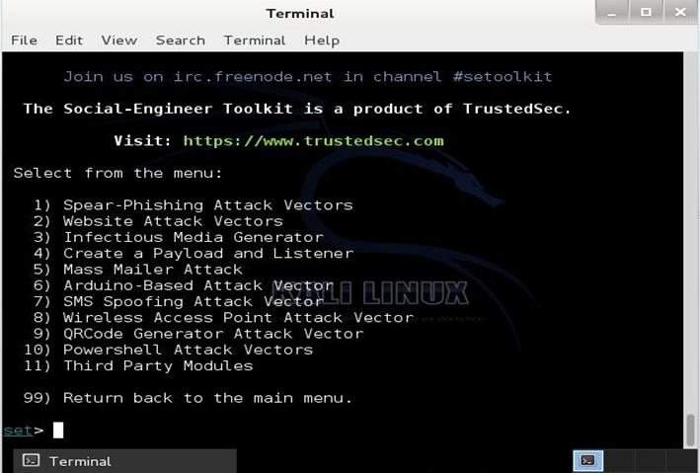
Social-Engineer Toolkit
73

Slide 74
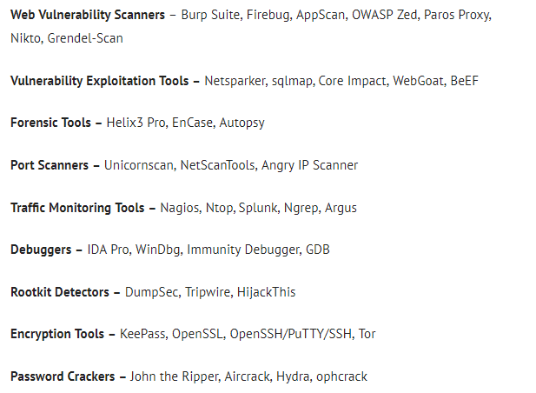
hacking and security tools in multiple categories
74

Slide 75
Brokers
Brokers - attackers who sell knowledge of a vulnerability to other attackers or governments
Often hired by the vendor to uncover vulnerabilities
Instead they do not report it to the vendor but sell the information about the vulnerabilities to the highest bidder
CompTIA Security+ Guide to Network Security Fundamentals, Fifth Edition
75
Notes:
75
Brokers
Brokers - attackers who sell knowledge of a vulnerability to other attackers or governments
Often hired by the vendor to uncover vulnerabilities
Instead they do not report it to the vendor but sell the information about the vulnerabilities to the highest bidder

Slide 76
Insiders
Employees, contractors, and business partners
Over 48 percent of breaches attributed to insiders
Examples of insider attacks:
Health care worker may publicize celebrities’ health records
Disgruntled over upcoming job termination
Stock trader might conceal losses through fake transactions
Employees may be bribed or coerced into stealing data before moving to a new job
CompTIA Security+ Guide to Network Security Fundamentals, Fifth Edition
76
Notes:
76
Insiders
Employees, contractors, and business partners
Over 48 percent of breaches attributed to insiders
Examples of insider attacks:
Health care worker may publicize celebrities’ health records
Disgruntled over upcoming job termination
Stock trader might conceal losses through fake transactions
Employees may be bribed or coerced into stealing data before moving to a new job

Slide 77
Cyberterrorists
Cyberterrorists - an attacker whose motivation may be ideological or for the sake of principles or beliefs
Almost impossible to predict when or where the attack may occur
Targets may include:
A small group of computers or networks that can affect the largest number of users
Example:
Computers that control the electrical power grid of a state or region
CompTIA Security+ Guide to Network Security Fundamentals, Fifth Edition
77
Notes:
77
Cyberterrorists
Cyberterrorists - an attacker whose motivation may be ideological or for the sake of principles or beliefs
Almost impossible to predict when or where the attack may occur
Targets may include:
A small group of computers or networks that can affect the largest number of users
Example:
Computers that control the electrical power grid of a state or region

Slide 78
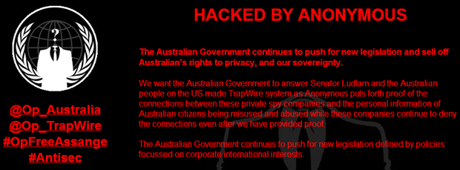
Hactivists
Hactivists - attackers who attack for ideological reasons that are generally not as well-defined as a cyberterrorist’s motivation
Examples of hactivist attacks:
Breaking into a website and changing the contents on the site to make a political statement
Disabling a website belonging to a bank because the bank stopped accepting payments that were deposited into accounts belonging to the hactivists
CompTIA Security+ Guide to Network Security Fundamentals, Fifth Edition
78
Notes:
Hactivists
Hactivists - attackers who attack for ideological reasons that are generally not as well-defined as a cyberterrorist’s motivation
Examples of hactivist attacks:
Breaking into a website and changing the contents on the site to make a political statement
Disabling a website belonging to a bank because the bank stopped accepting payments that were deposited into accounts belonging to the hactivists
78

Slide 79
State-Sponsored Attackers
State-sponsored attacker - an attacker commissioned by the governments to attack enemies’ information systems
May target foreign governments or even citizens of the government who are considered hostile or threatening
Examples of attacks:
Malware targeting government or military computers
Citizens having their email messages read without their knowledge
CompTIA Security+ Guide to Network Security Fundamentals, Fifth Edition
79
Notes:
State-Sponsored Attackers
State-sponsored attacker - an attacker commissioned by the governments to attack enemies’ information systems
May target foreign governments or even citizens of the government who are considered hostile or threatening
Examples of attacks:
Malware targeting government or military computers
Citizens having their email messages read without their knowledge
79

Slide 80
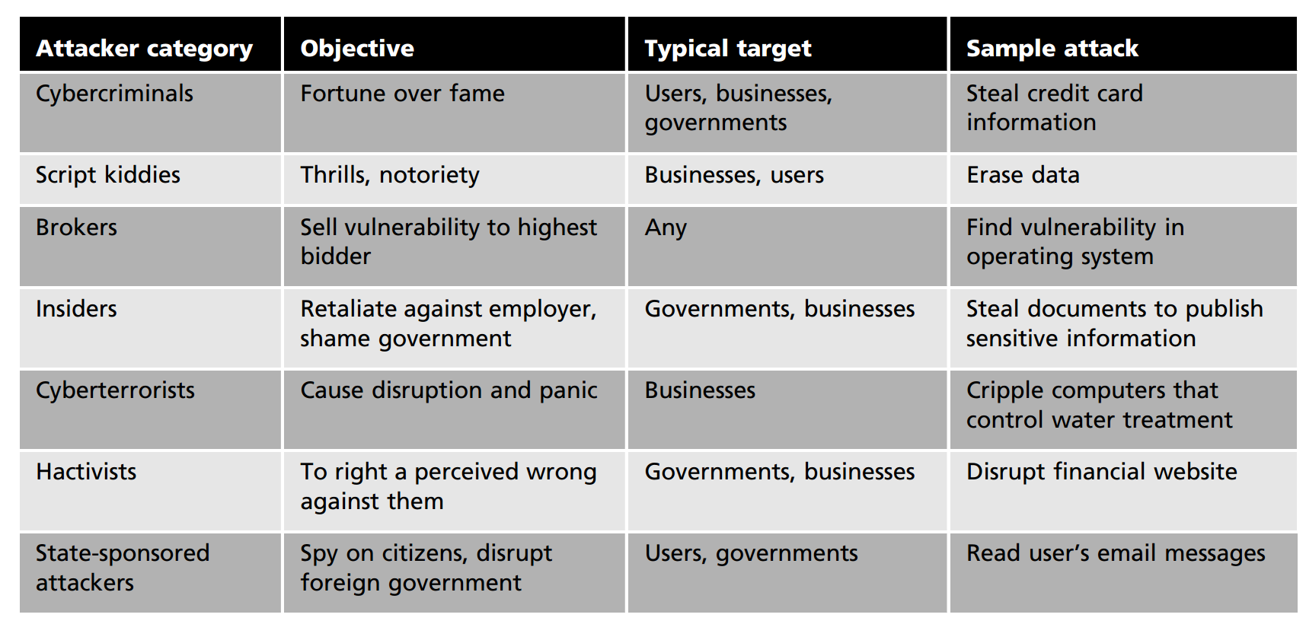
CompTIA Security+ Guide to Network Security Fundamentals, Fifth Edition
80

Slide 81
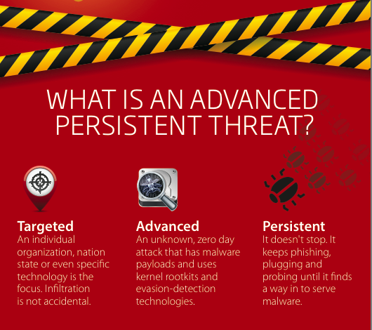
81
Notes:
https://www.kaspersky.com/resource-center/definitions/advanced-persistent-threats
81

Slide 82
Advanced Persistent Threat (APT)
As the name "advanced" suggests, an advanced persistent attack (APT) uses continuous, and sophisticated hacking techniques to gain access to a system and remain inside for a prolonged period of time, with potentially destructive consequences.
APTs are usually leveled at high value targets, such as nation states and large corporations, with the ultimate goal of stealing information over a long period of time.
CompTIA Security+ Guide to Network Security Fundamentals, Fifth Edition
82
Notes:
A well-crafted e-mail with the subject line "2011 Recruitment Plan" tricked an RSA employee to retrieve from a junk-mail folder and open a message containing a virus that led to a sophisticated attack on the company's information systems, a top technologist at the security vendor says in a blog.
An Excel spreadsheet attached to the e-mail contained a zero-day exploit that led to the installation of a backdoor virus, exploiting an Adobe Flash vulnerability
82

Slide 83
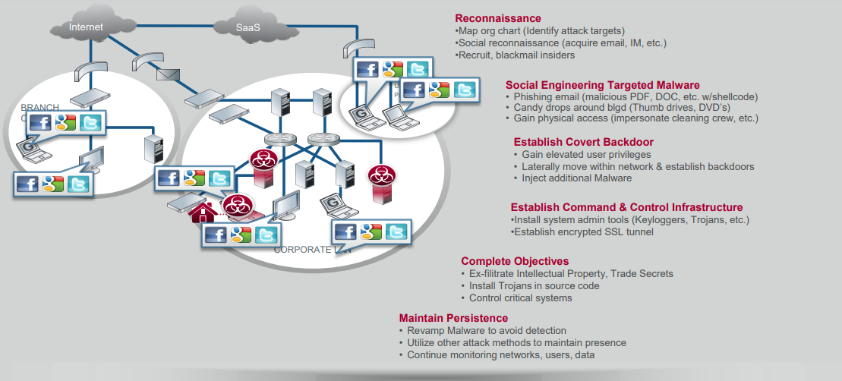
APT Network Security Attack
83
Notes:
https://www.sans.org/cyber-security-summit/archives/file/summit-archive-1493920814.pdf
83

Slide 84
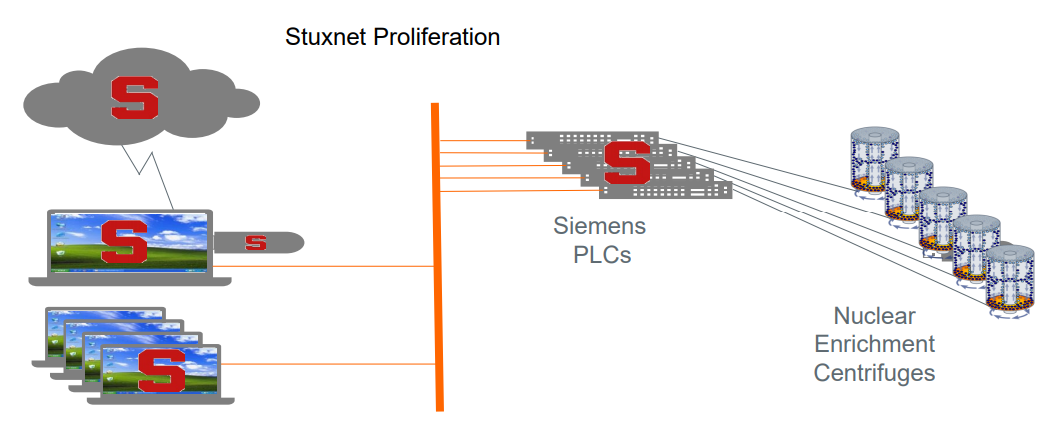
Advanced Persistent Threat (Example: Stuxnet)
Stuxnet had to target specific Siemens industrial control systems and CPUs. Additionally, the program had to determine that these systems were operating in Iran.
84
Notes:
https://www.sans.org/cyber-security-summit/archives/file/summit-archive-1493920814.pdf
84

Slide 85
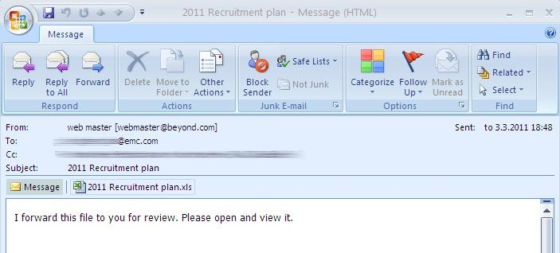

Advanced Persistent Threat (APT)
Examples of APTs include:
A well-crafted e-mail with the subject line "2011 Recruitment Plan" tricked an RSA employee to retrieve from a junk-mail folder and open a message containing a virus that led to a sophisticated attack on the company's information systems, a top technologist at the security vendor
85
Notes:
A well-crafted e-mail with the subject line "2011 Recruitment Plan" tricked an RSA employee to retrieve from a junk-mail folder and open a message containing a virus that led to a sophisticated attack on the company's information systems, a top technologist at the security vendor says in a blog.
An Excel spreadsheet attached to the e-mail contained a zero-day exploit that led to the installation of a backdoor virus, exploiting an Adobe Flash vulnerability
RSA unveiled on March 17 that an attacker targeted its SecurID two-factor authentication product in what it termed an advanced persistent threat breach
According to Rivner, the exploit injected malicious code into the employee's PC, allowing full access into the machine. The attacker installed a customized variant of a remote administration tool known as Poison Ivy, which has been used in APT attacks against other companies. Such tools set up a reverse-connect model, which Rivner explains pulls commands from the central command and control servers, then execute the commands, rather than getting commands remotely, making them harder to detect.
85

Slide 86
Attacks and Defenses
A wide variety of attacks can be launched
The same basic steps are used in most attacks
To protect computers against attacks follow five fundamental security principles
CompTIA Security+ Guide to Network Security Fundamentals, Fifth Edition
86
Notes:
86
Attacks and Defenses
A wide variety of attacks can be launched
The same basic steps are used in most attacks
To protect computers against attacks follow five fundamental security principles

Slide 87
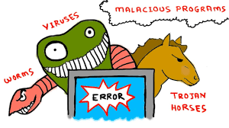
Steps of an Attack
Cyber Kill Chain outlines the steps of an attack:
1. Reconnaissance - probe for information about the system: type of hardware or software used
2. Weaponization - attacker creates an exploit (i.e. virus) and packages it into a deliverable payload (i.e. Microsoft Excel)
3. Delivery - weapon is transmitted to the target (such as by an email attachment or through an infected web server)
4. Exploitation - after weapon is delivered, the exploitation stage triggers the intruder’s exploit
5. Installation - the weapon is installed to either attack the computer or install a remote “backdoor”
Notes:
87
Steps of an Attack
Cyber Kill Chain outlines the steps of an attack:
1. Reconnaissance - probe for information about the system: type of hardware or software used
2. Weaponization - attacker creates an exploit and packages it into a deliverable payload
3. Delivery - weapon is transmitted to the target
4. Exploitation - after weapon is delivered, the exploitation stage triggers the intruder’s exploit
5. Installation - the weapon is installed to either attack the computer or install a remote “backdoor”

Slide 88
Steps of an Attack
Cyber Kill Chain outlines the steps of an attack (cont’d):
6. Command and Control - the comprised system connects back to the attacker so that the system can be remotely controlled by the attacker
7. Action on Objectives - now the attackers can start to take actions to achieve their original objectives
CompTIA Security+ Guide to Network Security Fundamentals, Fifth Edition
88
Notes:
88
Steps of an Attack
Cyber Kill Chain outlines the steps of an attack (cont’d):
6. Command and Control - the comprised system connects back to the attacker so that the system can be remotely controlled by the attacker
7. Action on Objectives - now the attackers can start to take actions to achieve their original objectives

Slide 89
Defenses Against Attacks
Five fundamental security principles for defenses:
Layering
Limiting
Diversity
Obscurity
Simplicity
CompTIA Security+ Guide to Network Security Fundamentals, Fifth Edition
89
Notes:
89
Defenses Against Attacks
Five fundamental security principles for defenses:
Layering
Limiting
Diversity
Obscurity
Simplicity

Slide 90
Layering
Information security must be created in layers
A single defense mechanism may be easy to circumvent
Making it unlikely that an attacker can break through all defense layers
Layered security approach
Can be useful in resisting a variety of attacks
Provides the most comprehensive protection
CompTIA Security+ Guide to Network Security Fundamentals, Fifth Edition
90
Notes:
90
Layering
Information security must be created in layers
A single defense mechanism may be easy to circumvent
Making it unlikely that an attacker can break through all defense layers
Layered security approach
Can be useful in resisting a variety of attacks
Provides the most comprehensive protection

Slide 91
Limiting
Limiting access to information:
Reduces the threat against it
Only those who must use data should be granted access
Should be limited to only what they need to do their job
Methods of limiting access
Technology-based - such as file permissions
Procedural - such as prohibiting document removal from premises
CompTIA Security+ Guide to Network Security Fundamentals, Fifth Edition
91
Notes:
91
Limiting
Limiting access to information:
Reduces the threat against it
Only those who must use data should be granted access
Should be limited to only what they need to do their job
Methods of limiting access
Technology-based - such as file permissions
Procedural - such as prohibiting document removal from premises

Slide 92
Diversity
Closely related to layering
Layers must be different (diverse)
If attackers penetrate one layer:
Same techniques will be unsuccessful in breaking through other layers
Breaching one security layer does not compromise the whole system
Example of diversity
Using security products from different manufacturers
CompTIA Security+ Guide to Network Security Fundamentals, Fifth Edition
92
Notes:
92
Diversity
Closely related to layering
Layers must be different (diverse)
If attackers penetrate one layer:
Same techniques will be unsuccessful in breaking through other layers
Breaching one security layer does not compromise the whole system
Example of diversity
Using security products from different manufacturers

Slide 93
Obscurity
Obscuring inside details to outsiders
Example: not revealing details
Type of computer
Operating system version
Brand of software used
Difficult for attacker to devise attack if system details are unknown
CompTIA Security+ Guide to Network Security Fundamentals, Fifth Edition
93
Notes:
93
Obscurity
Obscuring inside details to outsiders
Example: not revealing details
Type of computer
Operating system version
Brand of software used
Difficult for attacker to devise attack if system details are unknown

Slide 94
Simplicity
Nature of information security is complex
Complex security systems:
Can be difficult to understand and troubleshoot
Are often compromised for ease of use by trusted users
A secure system should be simple from the inside
But complex from the outside
CompTIA Security+ Guide to Network Security Fundamentals, Fifth Edition
94
Notes:
94
Simplicity
Nature of information security is complex
Complex security systems:
Can be difficult to understand and troubleshoot
Are often compromised for ease of use by trusted users
A secure system should be simple from the inside
But complex from the outside

Slide 95
Summary
Information security attacks have grown exponentially in recent years
It is difficult to defend against today’s attacks
Information security protects information’s integrity, confidentiality, and availability:
On devices that store, manipulate, and transmit information
Using products, people, and procedures
CompTIA Security+ Guide to Network Security Fundamentals, Fifth Edition
95
Notes:
95
Summary
Information security attacks have grown exponentially in recent years
It is difficult to defend against today’s attacks
Information security protects information’s integrity, confidentiality, and availability:
On devices that store, manipulate, and transmit information
Using products, people, and procedures

Slide 96
Summary
Main goals of information security
Prevent data theft
Thwart identity theft
Avoid legal consequences of not securing information
Maintain productivity
Foil cyberterrorism
Different types of people with different motivations conduct computer attacks
An attack has seven general steps known as the Cyber Kill Chain
CompTIA Security+ Guide to Network Security Fundamentals, Fifth Edition
96
Notes:
96
Summary
Main goals of information security
Prevent data theft
Thwart identity theft
Avoid legal consequences of not securing information
Maintain productivity
Foil cyberterrorism
Different types of people with different motivations conduct computer attacks
An attack has seven general steps known as the Cyber Kill Chain

